Slide 1
RC_week3
Yixuan Wang
2018/9/26

Slide 2
Content
Limit
Continuity
Exercise

Slide 3
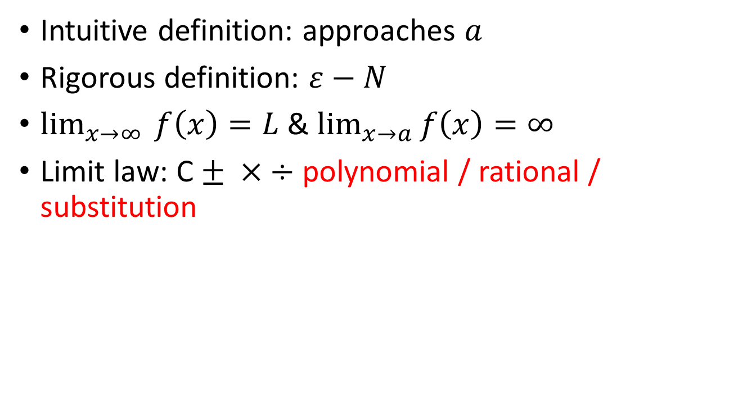
Limit
Intuitive definition: approaches $a$
Rigorous definition: $ε−N$
$\lim_{x→∞ }{f\left(x\right)}=L$ & $\lim_{x→a}{f\left(x\right)}=∞$
Limit law: C $± × ÷$polynomial / rational / substitution

Slide 4
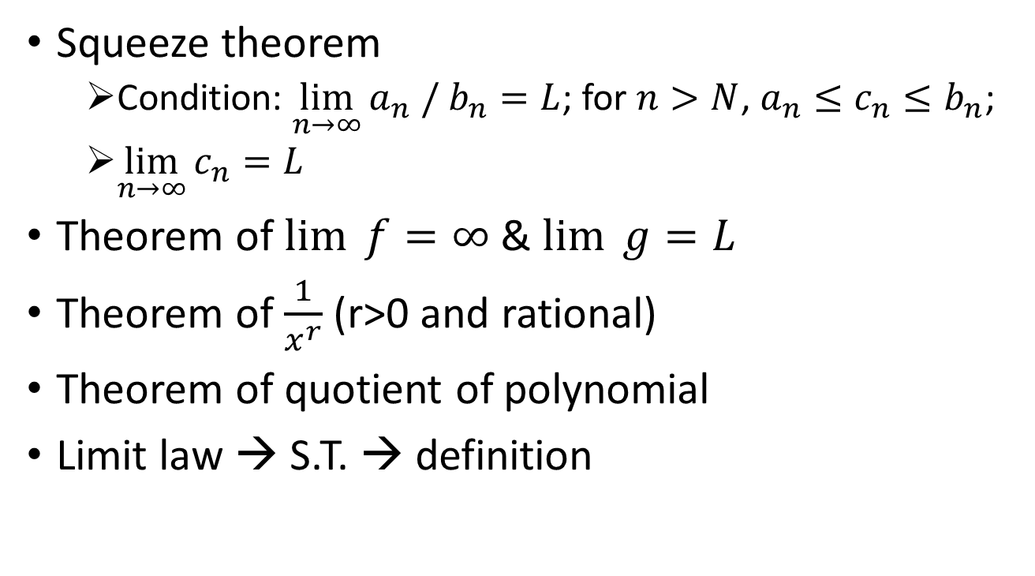
Limit
Squeeze theorem
Condition: $\lim_{n→∞}{a_{n} / b_{n}}=L$; for $n>N$, $a_{n}≤c_{n}≤b_{n}$;
$\lim_{n→∞}{c_{n}}=L$
Theorem of $\lim_{ }{f}=∞$ & $\lim_{ }{g}=L$
Theorem of $\frac{1}{x^{r}}$ (r>0 and rational)
Theorem of quotient of polynomial
Limit law → S.T. → definition

Slide 5
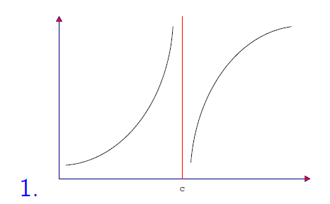
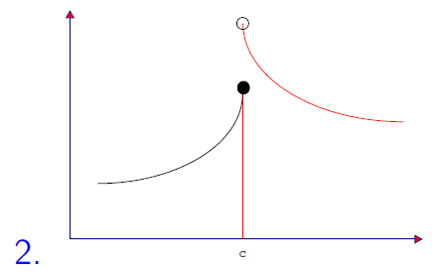
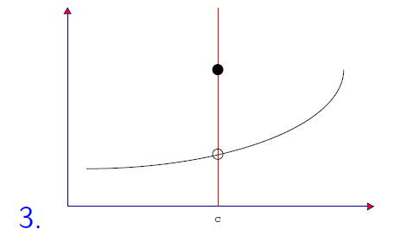

Continuity
Definition: $\lim_{x→c}{f(x)}=f(c)$ (if they exist)
Three kinds of discontinuity:
Continuous on closed interval
essential
jump
removable

Slide 6
Continuity
Continuous on a set and continuous
Theorem: similar to limit law (composite function)
Continuity is also a way to calculate limit.

Slide 7
Exercise
Q1: basic application of concept
Q2: a new way to find function to use squeeze theorem
Q3: substitution, and transformation
Q4: limit of sequence and function
Q5: definition of continuous

